Slide 1

Implementation of Augmented Reality and Virtual Reality in Different Fields
Presented By: Deepankar Sharma
(BCA IV),
Graphic Era Hill University

Slide 2

1 Artificial Intelligence (AI)
2 Computer Vision
KEYWORDS
3 Virtual Reality (VR)
4 Augmented Reality (AR)

Slide 3
Artificial Intelligence
Machines are Intelligent, Can make decisions
Tremendous amount of power the data holds
Computer Vision
Domain of AI -----> visual inferences from digital images, videos, etc
Virtual Reality
Sophisticated to replace the original real environment with an artificial environment
Augmented Reality
This artificial environment is augmented with read environment ----> parallel

Slide 4

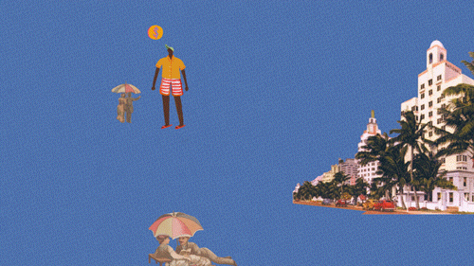

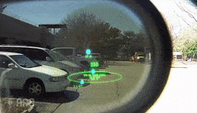
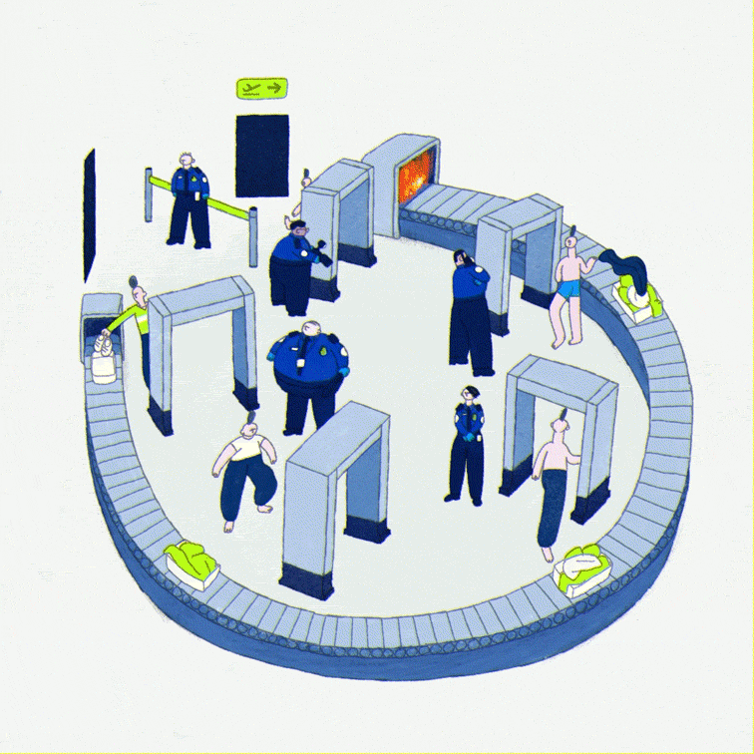
Applications of Augmented Reality and Virtual Reality
Public Safety
Public Safety

Slide 5
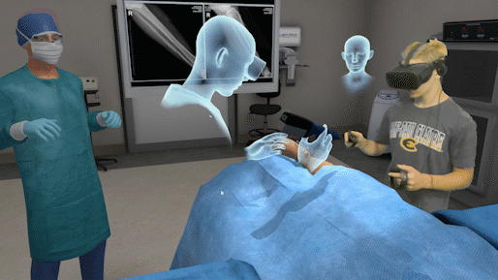
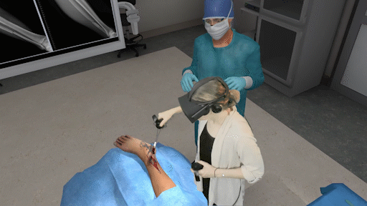
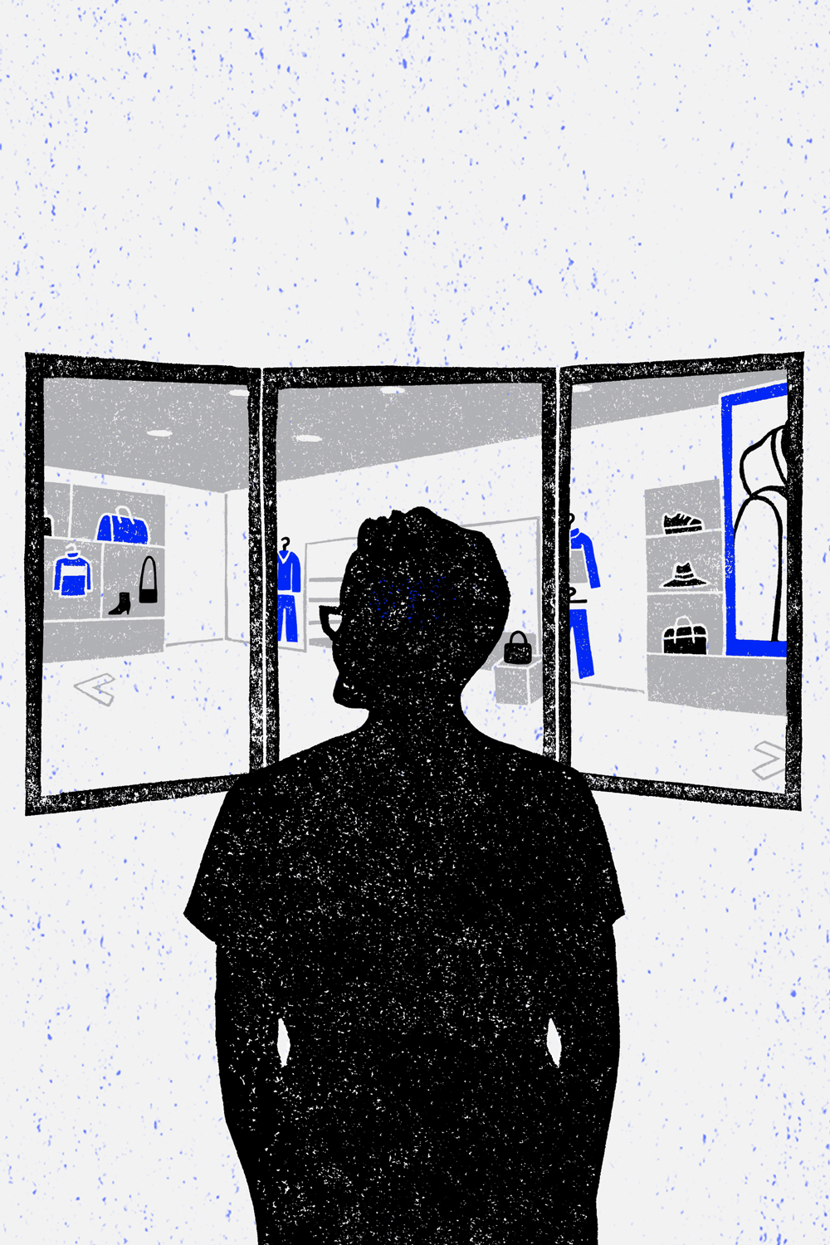
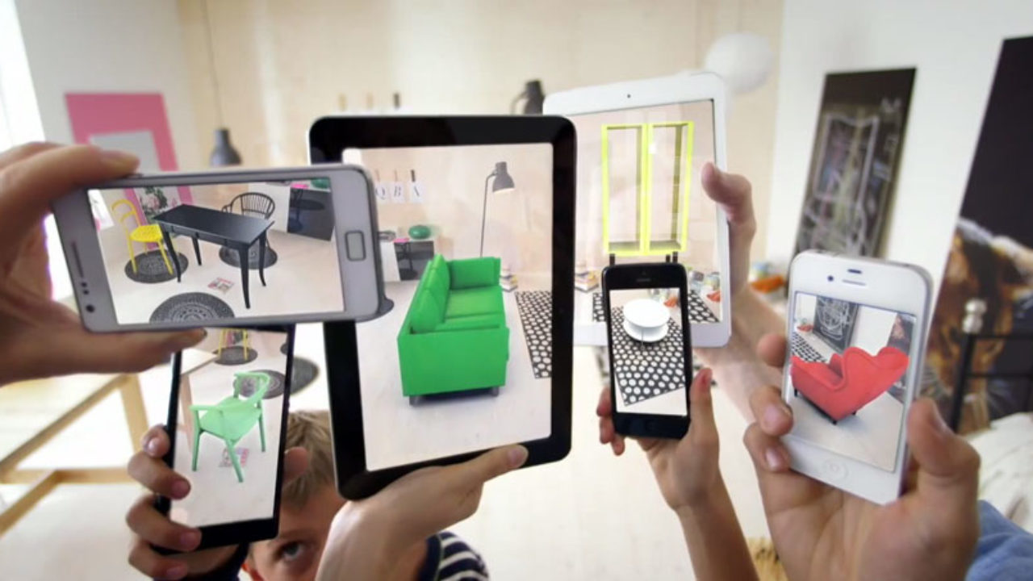

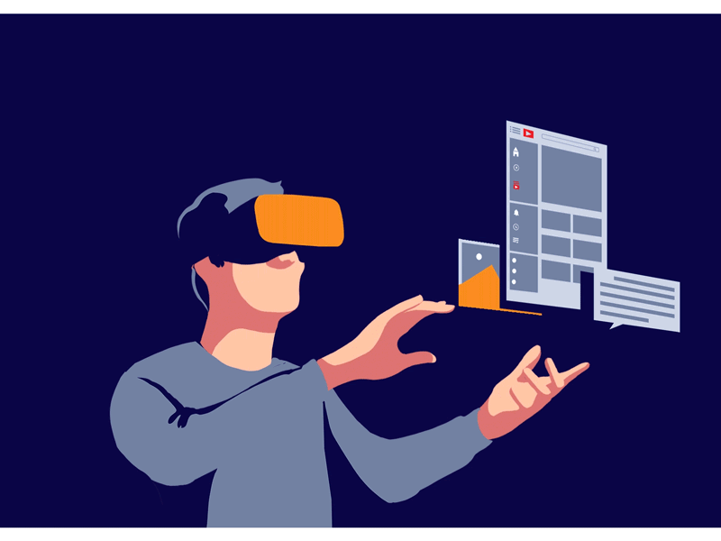
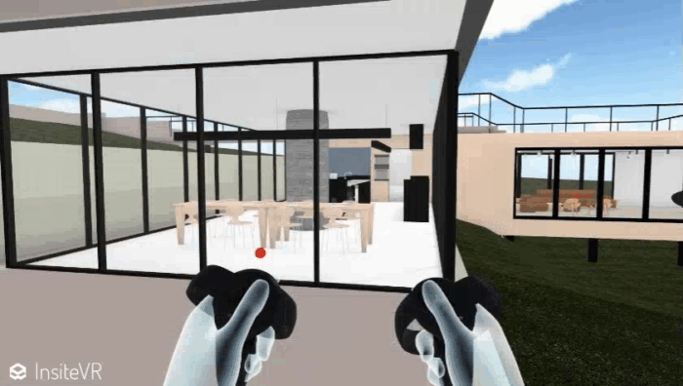
Medical Training
Retail
Design and Modelling

Slide 6
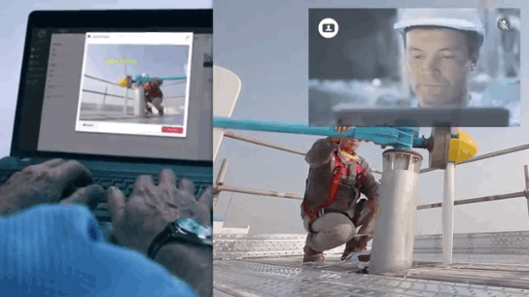
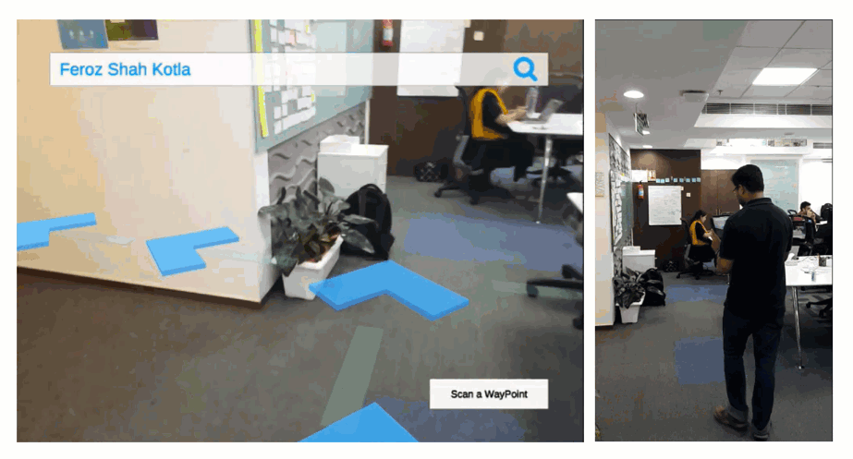
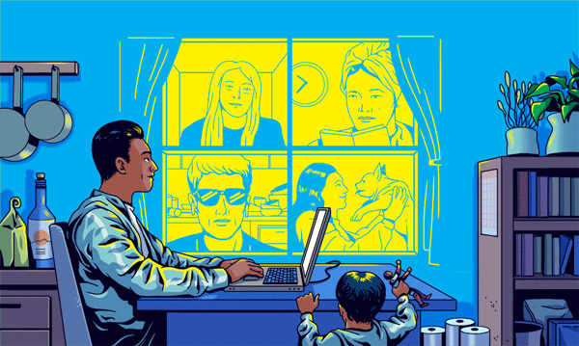
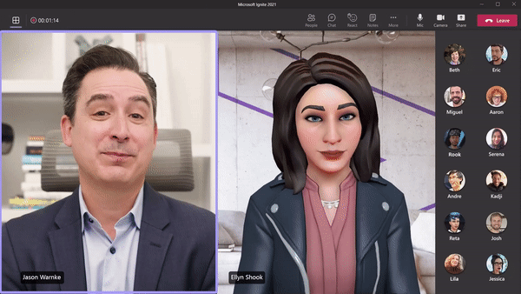
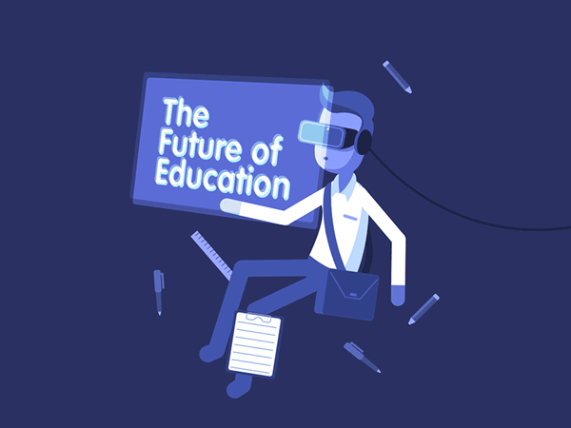
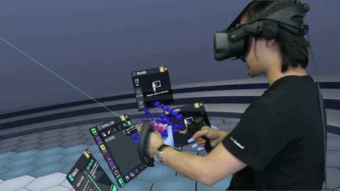
Repair and Maintenance
Business Logistics
Classroom Education

Slide 7
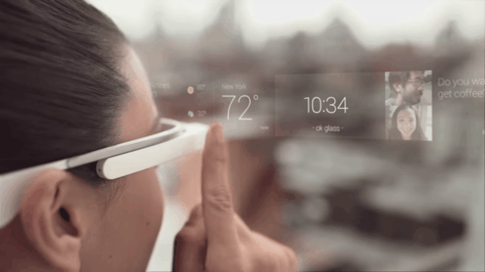
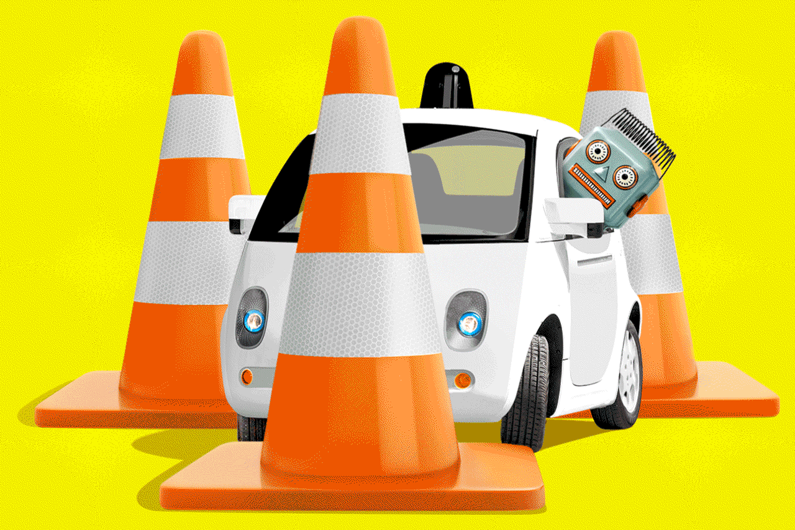
Potential Threats by AR and VR
AR could (further) privatize public spaces
AR glasses in public spaces
Unregulated “augmented sphere” imposed on our public spaces
Autonomous Driving
Can cause you to misjudge the speed of oncoming cars
Underestimate your reaction time

Slide 8
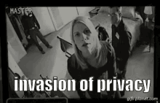
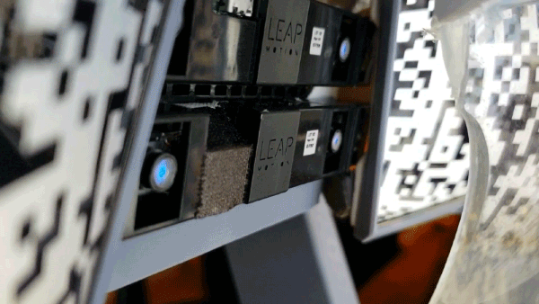
AR threatens our rights
Uses of AR to harm rights beyond privacy and data protection.
Mixing deepfakes with AR which is also called Synthetic Reality
Reality Distortion
Complex mixed reality ---> we could reach a time where it is difficult to distinguish between what is real and what is virtual
May distort actual reality in a misleading way

Slide 9
Feedback
?

Slide 10
THANK YOU

